Slide 1
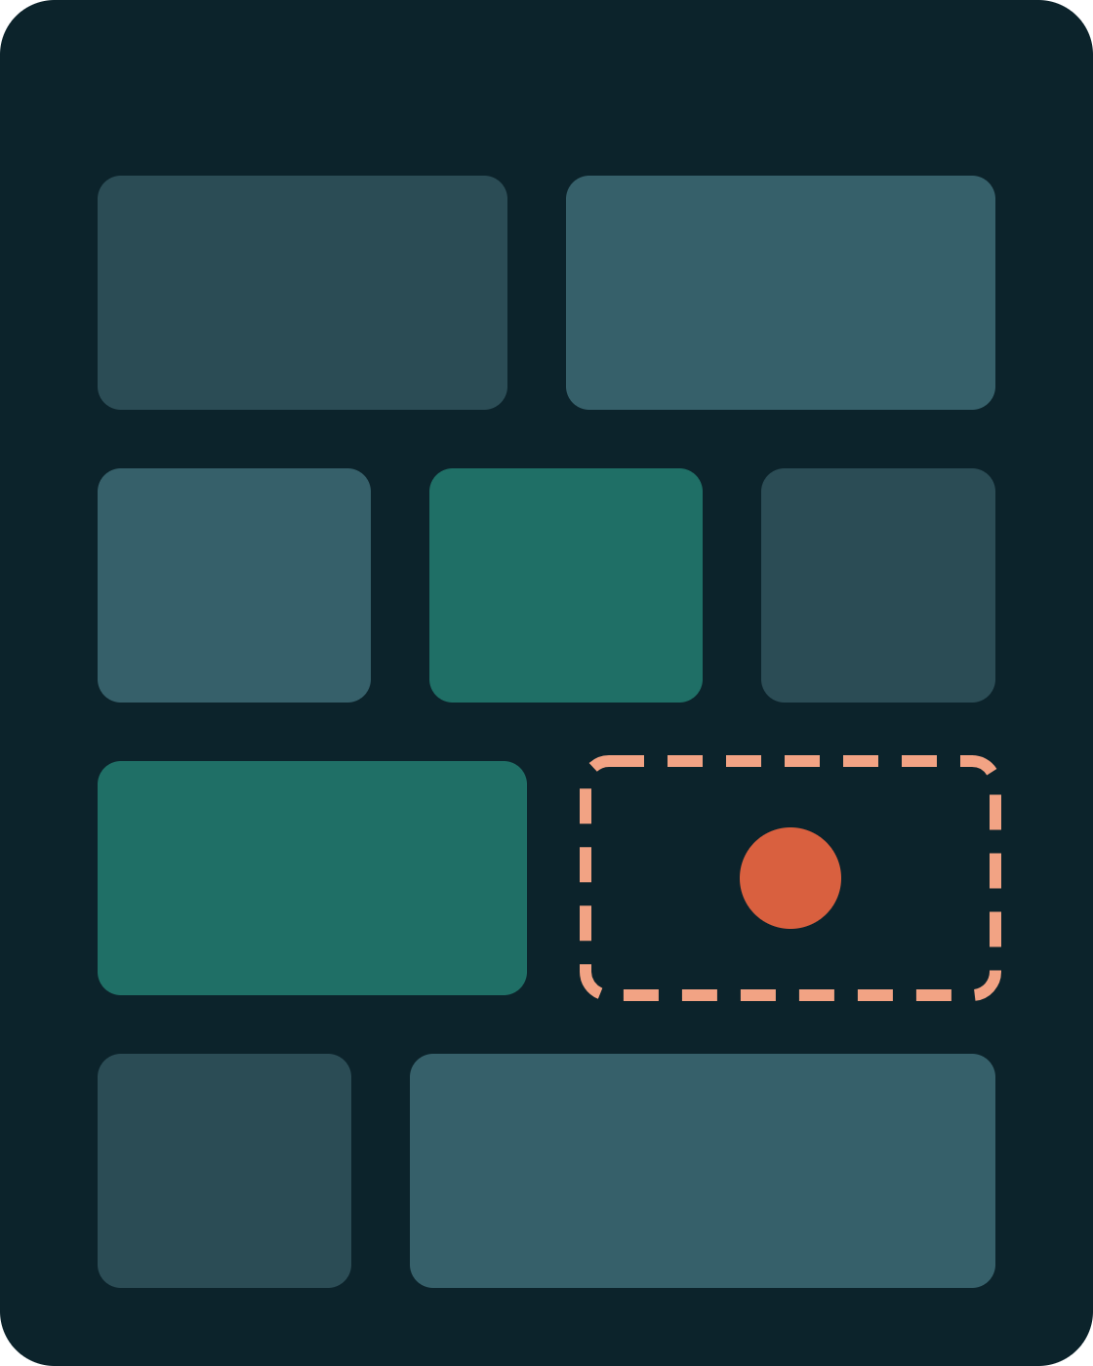
CSEG3060 · RESEARCH METHODOLOGY IN COMPUTER SCIENCE
UNIT III · PART 2
Literature Analysis & Synthesis
From a pile of papers to a research gap, continuing with brain tumour segmentation in MRI.
Dr. Mohsin Furkh Dar · School of Computer Science, UPES
Notes:
In Part 1, Priya built a reading list on brain tumour segmentation. Today she turns that list into understanding, and understanding into a research gap.

Slide 2
SESSION GOALS
By the end of this session, you can…
01
Explain the difference between analysis and synthesis
02
Read a paper critically with the three-pass method
03
Extract key elements into an extraction matrix
04
Synthesise literature thematically, methodologically and chronologically
05
Identify a research gap and write a gap statement
CSEG3060 · Unit III · Part 2 — Literature Analysis & Synthesis

Slide 3
THE CORE IDEA
Analysis examines the bricks. Synthesis builds the wall.
ANALYSIS · ONE PAPER AT A TIME
SYNTHESIS · ACROSS PAPERS
Take each paper apart
Weave the papers together
What did it do, how, on which data, with what result, and what are its weaknesses?
Where do they agree, disagree or build on each other, and what does none of them address?
“U-Net uses skip connections and was tested on 2D microscopy images.”
“U-Net variants dominate BraTS, but all assume four clean MRI sequences.”
The research gap is the hole left in the wall.
CSEG3060 · Unit III · Part 2 — Literature Analysis & Synthesis
Notes:
Most weak literature reviews are all analysis and no synthesis: a list of paper summaries. Examiners want the wall, not a pile of bricks.

Slide 4
A · CRITICAL READING
Read every paper in up to three passes
Pass 1
Pass 2
Pass 3
5–10 MINUTES
ABOUT AN HOUR
SEVERAL HOURS
The bird’s-eye view
The content
The deep dive
Title, abstract, introduction, headings, conclusion; glance at figures.
Study figures, tables and the method. Note data, metrics and baselines; skip proofs.
Mentally re-implement it. Question every assumption and choice.
Only for the 5–10 papers your work builds on.
Decide: is it relevant? Most papers stop here.
Output: one row in your extraction matrix.
Based on S. Keshav, “How to Read a Paper,” ACM SIGCOMM Computer Communication Review, 2007
Notes:
For Priya: U-Net, nnU-Net and Swin UNETR deserve a third pass because her work will build on them. Most papers from her search log only need pass 1.

Slide 5
A · CRITICAL READING
After pass 1, answer the five Cs: U-Net
The C | Question | Answer for U-Net (2015)
Category | What type of paper is it? | A method paper proposing a new architecture
Context | Which work does it build on? | Fully convolutional networks (Long et al., 2015)
Correctness | Are its assumptions valid for me? | Designed for 2D microscopy, not 3D brain MRI
Contributions | What is genuinely new? | Encoder–decoder with skip connections, trained from few images using heavy augmentation
Clarity | Is it well written and explained? | Yes: one architecture figure explains the whole design
Notice “Correctness”: a paper can be correct in its own setting and still not fit yours.
The five Cs are from S. Keshav, “How to Read a Paper,” 2007

Slide 6
A · CRITICAL READING
Six questions for any paper
1 · Data
2 · Baselines
3 · Metrics
Which dataset, which MRI sequences, how many patients? Is it like mine?
Compared against strong recent methods, or weak old ones?
Dice and Hausdorff distance per sub-region, or only pixel accuracy?
4 · Generalisation
5 · Reproducibility
6 · Limitations
Tested on scans from other hospitals and scanners?
Code, trained weights and data splits released?
What did the authors admit, and what did they leave out?
CSEG3060 · Unit III · Part 2 — Literature Analysis & Synthesis

Slide 7
A · CRITICAL READING · WHY METRIC 3 MATTERS
Suppose a tumour fills 1% of the voxels in a scan. A model that predicts “no tumour” everywhere is 99% accurate, and useless.
DICE SCORE
Dice measures overlap with the tumour itself, so the empty prediction scores 0. Papers that report only accuracy deserve suspicion.
Dice = 2|A ∩ B| / (|A| + |B|)
A = predicted tumour voxels · B = true tumour voxels
Notes:
This is simple arithmetic, not a real dataset figure. Ask students to compute Dice for the all-background prediction: A is empty, so the numerator is zero.

Slide 8
B · EXTRACTION MATRIX
One row per paper, same columns every time
Paper | Core idea | Evaluated on | Strength | Limit for your task
U-Net (2015) | Encoder–decoder with skip connections | 2D microscopy images | Learns from few images | 2D only; not MRI
3D U-Net (2016) | Same idea on 3D volumes | Volumetric microscopy | Uses 3D context | Memory-hungry
nnU-Net (2021) | Self-configuring U-Net pipeline | Many public challenge datasets | Strong baseline, no manual tuning | Heavy training compute
Swin UNETR (2022) | Swin transformer encoder, U-Net decoder | BraTS 2021 | Built for brain tumours | Large model; curated inputs
MedSAM (2024) | Promptable foundation model | Large multi-modality collection | Generalises across tasks | Needs a box prompt from a user
Read down a column and patterns appear. The last column is where gaps come from.
CSEG3060 · Unit III · Part 2 — Literature Analysis & Synthesis
Notes:
Build this in a spreadsheet, not in your head. Add columns you need: metrics reported, code available, MRI sequences used. The "Limit for Priya" column is judged against her goal, not a criticism of the paper in general.

Slide 9
B · THE CRITICAL INSIGHT
A benchmark scan is not a hospital scan
BraTS benchmark | Routine scan in a district hospital
All four MRI sequences (T1, T1ce, T2, FLAIR) | Often one or two sequences missing
Skull-stripped, co-registered, resampled | Raw scans at varying resolutions
Expert labels agreed by protocol | No labels at all
Scanners from contributing research centres | Different scanners and protocols
Evaluated offline on large GPUs | Modest hardware, results needed quickly
A high Dice score on BraTS does not guarantee a high Dice score in a district hospital.
CSEG3060 · Unit III · Part 2 — Literature Analysis & Synthesis
Notes:
This is what critical reading produces: not "the paper is wrong", but "the paper's conditions differ from mine". Every row here is a potential research gap.

Slide 10
C · SYNTHESIS
A summary lists papers. A synthesis makes an argument.
✗ SUMMARY
✓ SYNTHESIS
Ronneberger et al. proposed U-Net for biomedical segmentation. Isensee et al. proposed nnU-Net, which configures itself. Hatamizadeh et al. proposed Swin UNETR using transformers.
Since U-Net [1], encoder–decoder networks have dominated brain tumour segmentation, and both self-configuring pipelines [3] and transformer hybrids [4] now perform strongly on BraTS. However, these results assume curated inputs with all four MRI sequences and substantial GPU resources. How such models perform on incomplete, heterogeneous clinical scans with modest hardware remains insufficiently studied.
Three separate facts. No link, no point.
Connect the papers → contrast benchmark with reality → end on the gap
CSEG3060 · Unit III · Part 2 — Literature Analysis & Synthesis
Notes:
Read both paragraphs aloud. Ask students to underline the linking words in the synthesis: since, and, however. Those words carry the argument.

Slide 11
C · SYNTHESIS
Three ways to organise the same papers
Chronological
Thematic
Methodological
By time: how the field evolved.
By question: what the field keeps asking.
By how studies were done.
U-Net → 3D U-Net → nnU-Net → Swin UNETR → MedSAM
CNN vs. transformer vs. foundation model; 2D vs. 3D; benchmark vs. clinical validation
Architectures · loss functions · missing sequences · generalisation
Best for: background sections
Best for: most literature reviews
Best for: justifying your method
CSEG3060 · Unit III · Part 2 — Literature Analysis & Synthesis
Notes:
A good thesis chapter often mixes them: a short chronological background, a thematic core, and a methodological comparison just before the proposed method.

Slide 12
C · CHRONOLOGICAL SYNTHESIS
Each step fixed a limitation of the last
2015
2016
2018
2021
2022
2024
U-Net
3D U-Net, V-Net
Attention U-Net
nnU-Net
Swin UNETR
MedSAM
Skip connections; learns from few images
Whole volumes; V-Net trains with a Dice loss
Learns where in the image to focus
Configures itself for each new dataset
Transformer encoder, tested on BraTS
Promptable foundation model
Written as a paragraph: “Segmentation research moved from 2D to 3D, then from hand-tuned to self-configuring pipelines, and most recently to transformers and foundation models…” The next step on the line is where your work goes.
CSEG3060 · Unit III · Part 2 — Literature Analysis & Synthesis

Slide 13
C · THEMATIC SYNTHESIS
Group your papers by the question they answer
Architectures
Many papers
Loss functions
Many papers
U-Net family vs. transformer hybrids. They agree skip connections matter; they debate whether transformers justify their cost.
Shared problem: tiny tumours, huge background. Dice loss (V-Net) and Dice + cross-entropy are the common answers.
Missing sequences
Few papers
Generalisation
Few papers
Hetero-modal methods such as HeMIS (Havaei et al., 2016) segment with whichever MRI sequences are available.
Scanner and protocol differences are widely recognised, yet few of her papers test on data outside BraTS.
Crowded themes show where the field agrees. Thin themes point to gaps.
CSEG3060 · Unit III · Part 2 — Literature Analysis & Synthesis
Notes:
The "many / few" tags describe Priya's reading list in this worked example, not a measured count of the whole field. Students should derive these tags from their own search logs.

Slide 14
C · SYNTHESIS TOOL
A concept matrix makes the gap visible
Paper | 3D context | Transformer | Auto-config | BraTS data | Missing MRI
U-Net (2015) | — | — | — | — | —
3D U-Net (2016) | ✓ | — | — | — | —
HeMIS (2016) | — | — | — | ✓ | ✓
nnU-Net (2021) | ✓ | — | ✓ | ✓ | —
Swin UNETR (2022) | ✓ | ✓ | — | ✓ | —
Your study? | ✓ | ✓ or — | — | ✓ | ✓
No paper in the list combines a modern 3D architecture with robustness to missing sequences. That empty intersection is your gap.
Concept matrix idea: Webster & Watson, MIS Quarterly, 2002 · Ticks reflect each paper’s main contribution
Notes:
Columns are concepts, rows are papers. Where a column is nearly empty, or where no row ticks a particular combination, you have a candidate gap. A real review would contain many more rows; this is a teaching subset.

Slide 15
D · RESEARCH GAPS
Five kinds of gap to look for
Gap type | Question to ask | Your version
Context | Tested in this setting? | Routine scans from Indian hospitals, not only BraTS
Data | Is there suitable data? | Few public, labelled sets with realistic missing sequences
Method | Does the method handle this condition? | Modern 3D models assume all four sequences
Evaluation | Are the right things measured? | Dice reported; inference time on modest GPUs rarely is
Population | Does it work equally for all groups? | Performance across tumour grades and age groups seldom broken down
Pick one or two. A gap that tries to fix everything is really a scope problem.
CSEG3060 · Unit III · Part 2 — Literature Analysis & Synthesis
Notes:
Priya's versions are hypotheses from her reading list. Before claiming any gap in writing, she must search specifically for papers that might already fill it; a gap is only real if a targeted search confirms it.

Slide 16
D · RESEARCH GAPS
From gap to gap statement
TEMPLATE
“Although [prior work] has achieved [result] under [conditions], [specific limitation] remains unaddressed, particularly for [your context]. This study addresses it by [your approach].”
Your GAP STATEMENT
“Although 3D encoder–decoder and transformer models perform strongly on the BraTS benchmark, they assume all four MRI sequences are available, a condition often unmet in routine clinical practice. This study evaluates and adapts a lightweight 3D segmentation model that remains accurate when one or more sequences are missing, tested on scans from Indian hospitals.”
Notes:
Notice the gap statement came out of the literature, not out of nowhere. Every clause can be traced back to a slide today: the benchmark-vs-clinic table, the concept matrix and the gap types. This is also the bridge to writing SMART objectives from Unit I.

Slide 17
TRY IT · 30 MINUTES
Turn your Part 1 reading list into a gap
Analyse
Synthesise
Pass-1 read five papers from your log
Answer the five Cs for one of them
Fill a five-column extraction matrix
Build a concept matrix of four concepts
Write one synthesis paragraph, not a summary
End it with a gap statement using the template
Notes:
Pairs keep the same topic as in the Part 1 activity (polyp, retinal vessel, skin lesion or lung segmentation). Collect the gap statements; they feed the ethics discussion in Part 3.

Slide 18
KEY TAKEAWAYS
From papers to a problem worth solving
1
Read in passes; save the deep read for the papers you build on.
2
Judge each paper against your conditions, not only its own.
3
Synthesis connects, contrasts and ends on what is missing.
4
A real gap is traced to the literature and confirmed by a targeted search.
Next · Part 3: Research ethics, using patient MRI data responsibly

